Slide 1


Aether Shield
High-Performance Deepfake Detection Platform
Multi-Modal Forensics + C2PA Provenance Ledger
Shiva Reddy · June 18, 2026
github.com/Shivareddy0/Deepfake

Slide 2

Problem Statement
Rise of Generative AI
Business Impact
GANs, diffusion models & TTS now produce hyper-realistic synthetic media at scale
Identity fraud, misinformation campaigns & erosion of enterprise trust
Current Solutions Fail
Market Gap
Single-model, high latency, vulnerable to adversarial attacks
Need for production-grade multi-modal detection with provenance

Slide 3
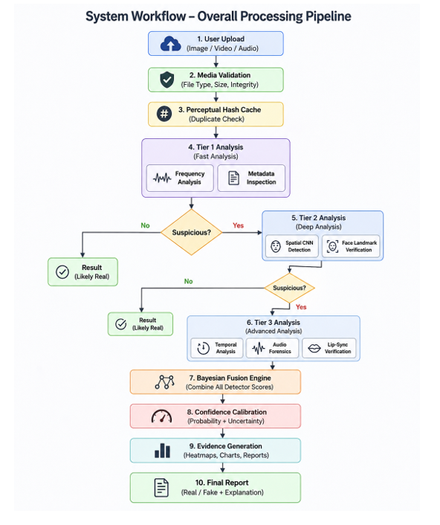
Core Architecture
Key Design Principles
10-stage pipeline: upload, validation, hash cache, then tiered detection through Bayesian fusion to final report
Multi-tiered routing (T1→T2→T3) skips heavy models for obvious results
Bayesian ensemble fusion with Monte Carlo weight sampling
Five forensic modalities: freq, spatial, temporal, audio, metadata
Goal: sub-second latency with >90% AUC-ROC

Slide 4


Technology Stack
Backend
Frontend
FastAPI
PyTorch (CNN models)
OpenCV (spatial ops)
SciPy (audio)
Scikit-Learn (SVM)
Next.js 14 (App Router)
React + TypeScript
GradCAM overlays
Audio spectrograms viewer

Slide 5
Core Forensic Detectors
01
Frequency Domain
02
Spatial CNN
03
Temporal Coherence
2D FFT + One-Class SVM
Detects GAN/diffusion artifacts in PSD
MiniEfficientNet / ConvNeXt
GradCAM++ pixel heatmaps
EAR, optical flow variance
Identity embedding drift
04
Audio Analysis
05
Metadata / C2PA
LPC formants, nPVI cadence
Mel-ResNet18 classifier
EXIF/XMP forensics
C2PA manifest verification

Slide 6
Deep Dive — Frequency Domain Detector
Input Image
How It Works
Converts image to frequency domain using 2D FFT
Computes azimuthal Power Spectral Density (PSD) radial profile
Natural images follow 1/fᵅ statistics — GANs/diffusion models leave upsampling & grid artifacts
One-Class SVM trained on real images flags anomalous spectra
Fast, low-cost: ideal for Tier 1 routing (no GPU needed)
2D FFT → Magnitude Spectrum
Azimuthal PSD Radial Profile
One-Class SVM Anomaly Score
FAKE / GENUINE Output

Slide 7

Deep Dive — Spatial CNN Detector
Model Architecture
CNN Pipeline
MiniEfficientNet (lightweight, fast) or ConvNeXt (high accuracy)
Binary cross-entropy fine-tuned on FaceForensics++ & DFDC datasets
GradCAM++ generates pixel-level attention heatmaps for analysts
Final sigmoid score = probability of manipulation
Image Input (224×224 RGB)
MiniEfficientNet / ConvNeXt
Feature Extraction
GradCAM++ Heatmap
Binary Output Score

Slide 8

Temporal & Audio Detectors
Temporal Coherence
Audio Analysis
EAR (Eye Aspect Ratio)
LPC Formant VTL Check
Tracks blink patterns; synthetic faces often blink unnaturally
Vocal Tract Length must match claimed speaker demographics
Optical Flow Variance
nPVI Cadence Analysis
Measures inter-frame pixel motion consistency across video
Normalized Pairwise Variability Index — TTS lacks natural rhythm
Identity Embedding Drift
Mel-ResNet18 Classifier
Face embedding distance between frames — real faces are stable
Mel-spectrogram CNN trained on ASVspoof & WaveFake datasets

Slide 9
Bayesian Ensemble Fusion
⚠ Problem: Naive Averaging Fails
Fusion Pipeline
Detector scores are correlated — averaging ignores uncertainty and inter-model dependencies, leading to overconfident predictions.
Detector Scores [D1, D2, D3, D4, D5]
MC Weight Sampling
✓ Solution: Bayesian Meta-Classifier
Weighted Ensemble Score
Monte Carlo weight sampling over detector ensemble
Temperature scaling for calibrated probabilities
Epistemic uncertainty quantification via variance
High variance → 'Requires Human Review' flag
Online adaptation as new models are deployed
Temperature Scaling
Uncertainty < θ?
Final Verdict + Confidence

Slide 10
Front-End Dashboard & User Experience
📥 Media Upload
🔎 Detection Process
📊 Results Dashboard
Upload Image / Video / Audio
File preview before analysis
Simple and user-friendly interface
Image → Custom trained model
Video → Frame extraction + pretrained model
Audio → Pretrained audio analysis
Real / Fake prediction
Confidence score display
Detection explanation
Processing time display
📤 Upload ➤ Preprocess ➤ Detection ➤ ✅ Result

Slide 11
Demo & How to Run Locally
1. Upload Media
2. Tiered Inference
3. GradCAM + PSD
4. Ledger Proof
Backend Setup
Frontend Setup
cd backend
python -m venv venv
.\venv\Scripts\Activate.ps1
pip install -r requirements.txt
uvicorn backend.main:app --reload --port 8000
cd frontend
npm install
npm run dev
Open http://localhost:3000

Slide 12
Challenges Faced & Solutions
⚠ Challenge : Heterogeneous Datasets & Class Imbalance
Problem: Training on CIFAKE, FaceForensics++, Celeb-DF, DFDC & DiffusionDB together caused severe class imbalance and instability, since some datasets had millions of frames and others only a few thousand.
✔ Solution: Built a custom PyTorch Weighted Random Sampler that weights samples by dataset density and class label, guaranteeing uniform representation of minor classes and datasets in every training batch.
⚠ Challenge : CPU/GPU Ingest Bottlenecks & Latency
Problem: Running EfficientNet-B4, Mel-spectrogram ResNet18 & Wav2Vec2 on high-resolution video is resource-intensive, backing up processing queues and blocking real-time execution.
✔ Solution: Built a Multi-Tiered Decision Router — Tier 1 (CPU, <10ms) runs dHash + 2D FFT checks; Tier 2/3 (GPU, <250ms) run CNN/temporal models only on ambiguous or video/audio assets, keeping genuine media sub-second.
⚠ Challenge : Generalizing to Unseen Generation Methods
Problem: Supervised models overfit to dataset-specific signatures and fail on new, unseen generators like Stable Diffusion 3 or VALL-E.
✔ Solution: Built a Bayesian Ensemble Fusion Core blending neural outputs with handcrafted forensics — visual: CNN (80%) + FFT radial power (20%); acoustic: ResNet spectrogram (70%) + formant/nPVI/spectral-flatness cues (30%) — so physical constraints catch what the network misses.

Slide 13
Results & Future Scope
✅ Results
Built a multi-modal deepfake detection platform
Trained and tested image detection model
Achieved practical detection with improved usability
🚀 Future Scope
Improve image accuracy with larger datasets
Add real-time webcam detection
Support live video stream analysis
Deploy on cloud for scalability
Enhance UI and reporting features
📚 Lessons Learned
Data quality directly affects accuracy
Model optimization improves performance
Pretrained models reduce development time

Slide 14
Thank You!
Deepfake Shield — Keeping Digital Media Authentic
Shiva Reddy
github.com/Shivareddy0/Deepfake
Open for Questions

